Slide 1
POWER BI AND SQL PROJECT : Internet Sales Report
By Amirul afiq rosli

Slide 2
Introduction
The Process flows
I successfully completed a project that involved utilizing SQL to clean the dataset, accessing an additional dataset through Excel files, and leveraging Power BI to create a business intelligence dashboard for visualization purposes.
Identify Objectives
Find Dataset
Cleaning Dataset
Upload Excel File and the Cleaned Dataset into PowerBI
Upload Into Github
Making Interactive Dashboard

Slide 3
Identify Objectives
Objectives :
Conducting sales analysis to identify best-selling products.
Identifying the products that customers buying the most.
Assessing sales performance over time, comparing it to the budget for evaluation.
What to do?
Creating a comprehensive dashboard providing an overview of internet sales, highlighting key metrics,
trends, and performance indicators.
2. Developing a detailed analysis of internet sales per customers, utilizing visualizations and data insights
to understand customer behavior, preferences, and purchasing patterns.
3. Generating a comprehensive overview of internet sales per products, utilizing visualizations to analyze
product performance, identify best-selling items, and uncover opportunities for growth and optimization.

Slide 4
Find Dataset
Sources:
Dataset name : AdventureWorksDW2019.bak
First Link : https://learn.microsoft.com/en-us/sql/samples/adventureworks-install-configure?view=sql-server-ver15&tabs=ssms
Second Link : https://www.sendspace.com/file/z2s0gv
I followed the tutorial from this Youtube Playlist: https://youtube.com/playlist?list=PLMfXakCUhXsEUtk8c0zWr4whamGxLhAu0
This is the Github link of another source like complete dashboard from this Youtuber:
https://github.com/aliahmad-1987/DataAnalystProjectFromScratch_PBI_SQL_SalesAnalysis

Slide 5
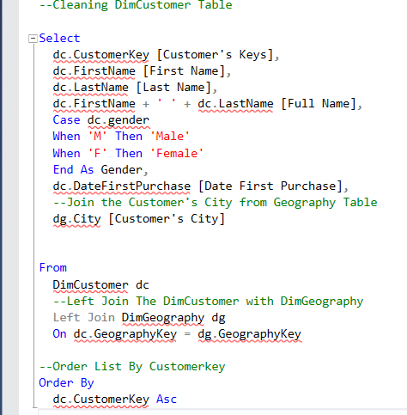
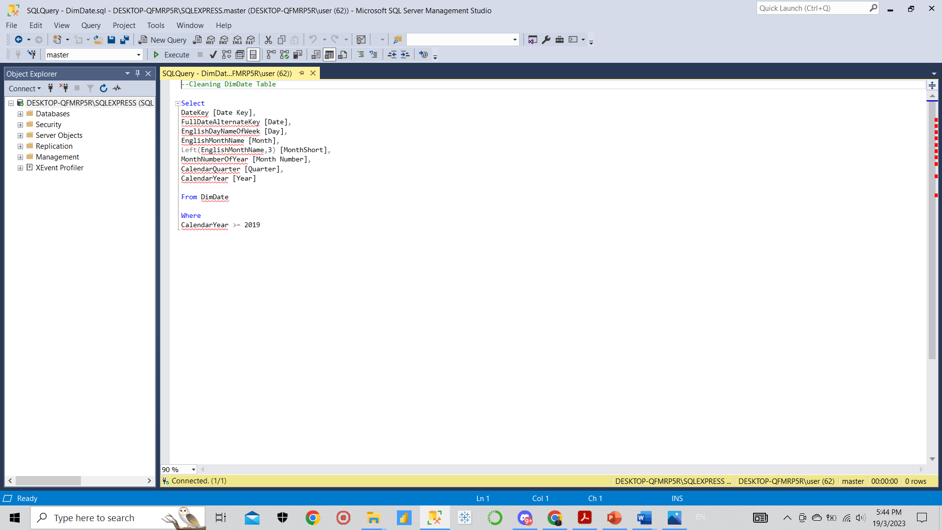
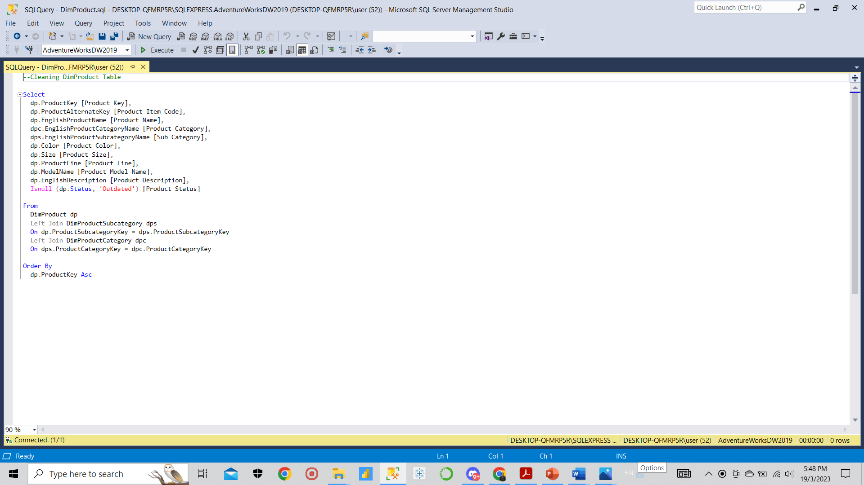
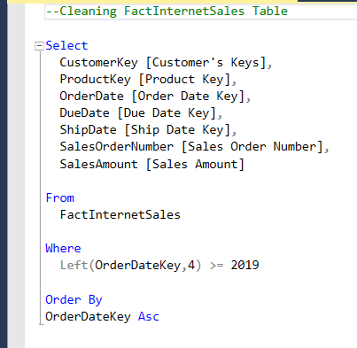
Cleaning Dataset
Tools :
SQL Server Management Studio Management Studio 19
What to do?
Performed data cleaning on the DimCustomer, DimDate, DimProduct, and FactInternetSales tables from the AdventureWorksDW2019.bak database.
Ensured data integrity and quality to extract a clean and meaningful dataset for further analysis and reporting purposes.
The queries done :

Slide 6
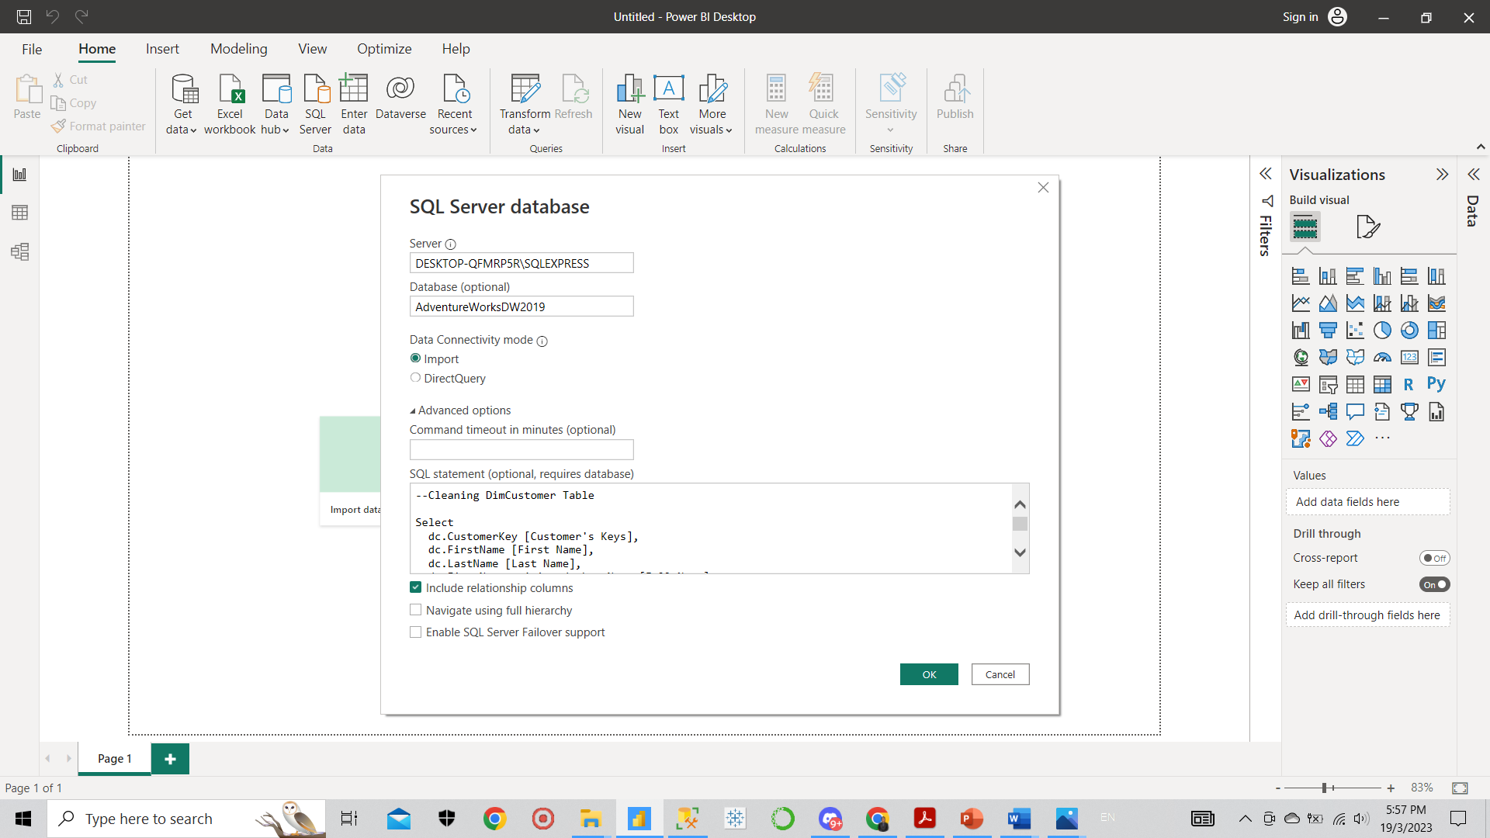
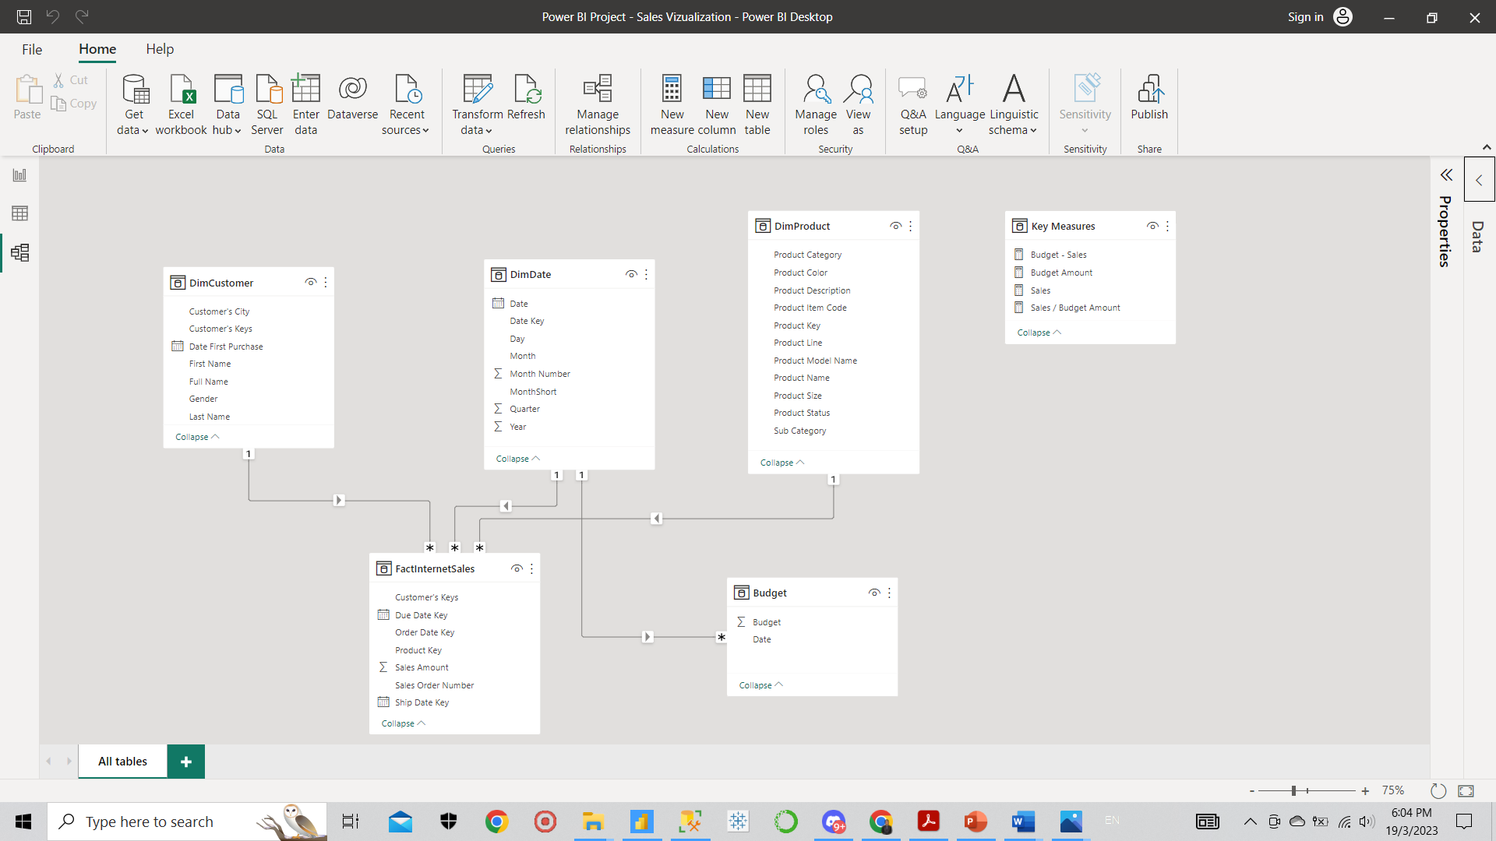
Upload Excel File and the Cleaned Dataset into PowerBI
Tools :
PowerBi
What to do?
Uploading the cleaned datasets, including the DimCustomer, DimDate, DimProduct, and FactInternetSales tables, from the AdventureWorksDW2019.bak database to Power BI for further analysis and visualization.
Integrating the Budget Dataset, which is an Excel file, into Power BI by importing and connecting it to the existing database tables.
Establishing database connections and performing data modeling in Power BI to create relationships between the different tables, ensuring accurate data integration and enabling comprehensive analysis.
Upload queries to PowerBI

Slide 7
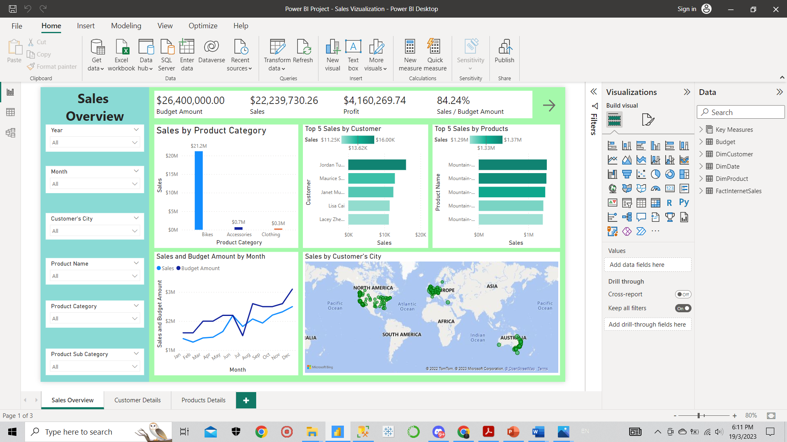
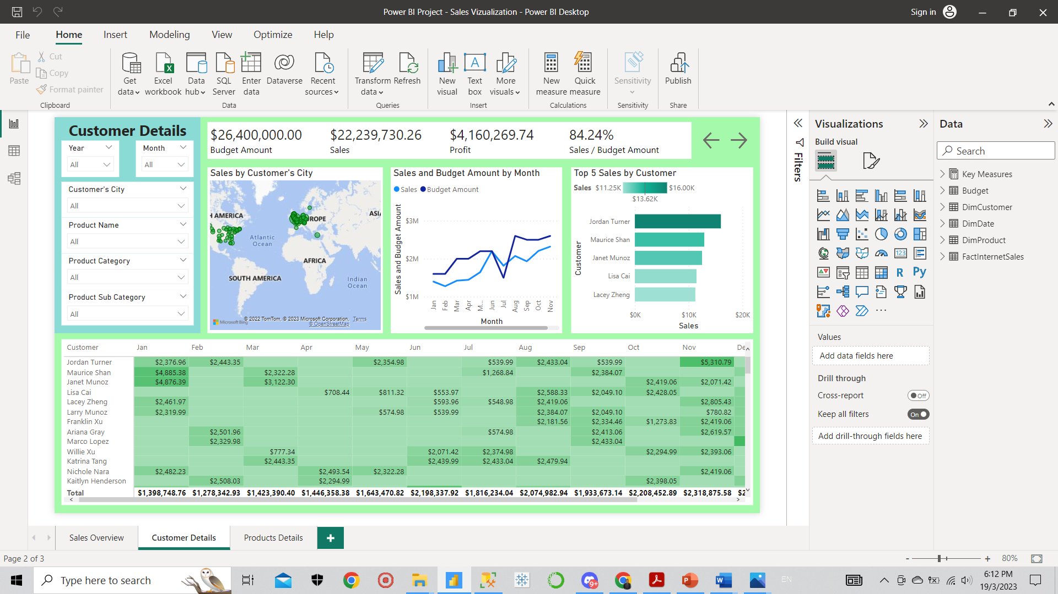
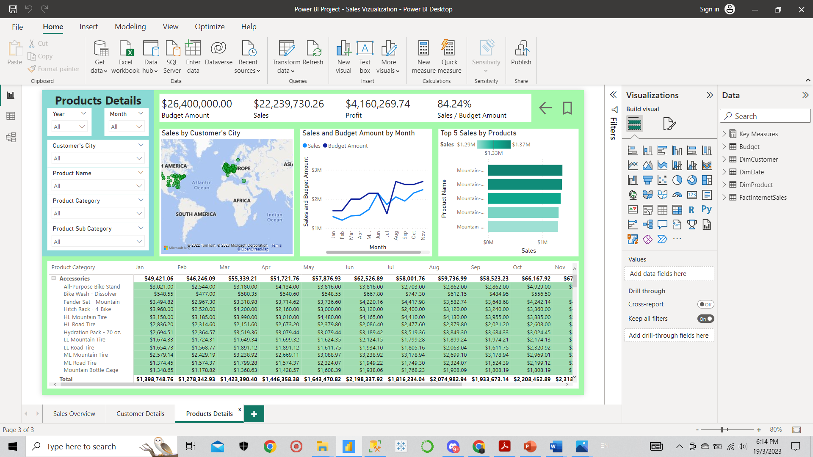
Making Interactive Dashboard
What to do?
Developing the Sales Overview page, Customer Details page, and , Product Details page.

Slide 8
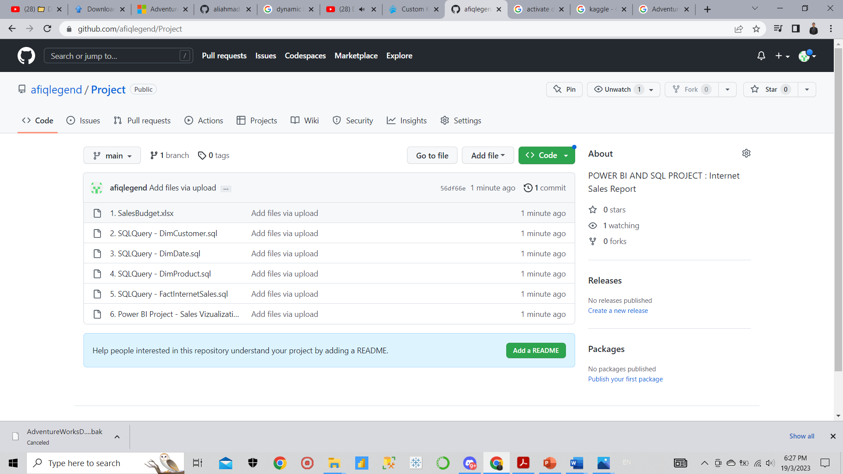
Upload Into Github
What to do?
Upload all my project files into Github for completing the portfolio.
Link : https://github.com/afiqlegend/Project

Slide 9
Conclusions
Extracted key findings from Power BI visualizations, including:
1. The best-selling product, Bike, generated sales of $21.2M.
2. Jordan Turner emerged as the top customer with total purchases amounting to $15,999.10.
3. Sales exhibited an upward trend throughout the year, aligning with the budget, from January to
December.
What I have learnt:
Proficiency in writing SQL queries in SSMS to clean datasets and extract relevant information for reporting and visualization purposes.
Expertise in data modeling in Power BI, ensuring proper connections and relationships between tables for accurate and comprehensive analysis.
Proficient in creating interactive dashboards that effectively summarize complex data, utilizing visual elements to facilitate easier data absorption and understanding.
Familiarity with fundamental business logics, enabling a deeper understanding of how organizations operate and make informed decisions.

